Slide 1
Supplier Sustainability Self Assessment
Guidelines
January 2022

Slide 2
Sustainability Self Assessement Guide
Supplier Sustainability Self Assessment
Access through the
CNH Industrial Supplier Portal
https://supplier.cnhind.com/

Slide 3
Sustainability Self Assessement Guide
User without a User ID (see page 4)
User with a User ID (see page 9)
Help desk and support (see page 23)

Slide 4
Sustainability Self Assessement Guide
User without an User ID

Slide 5
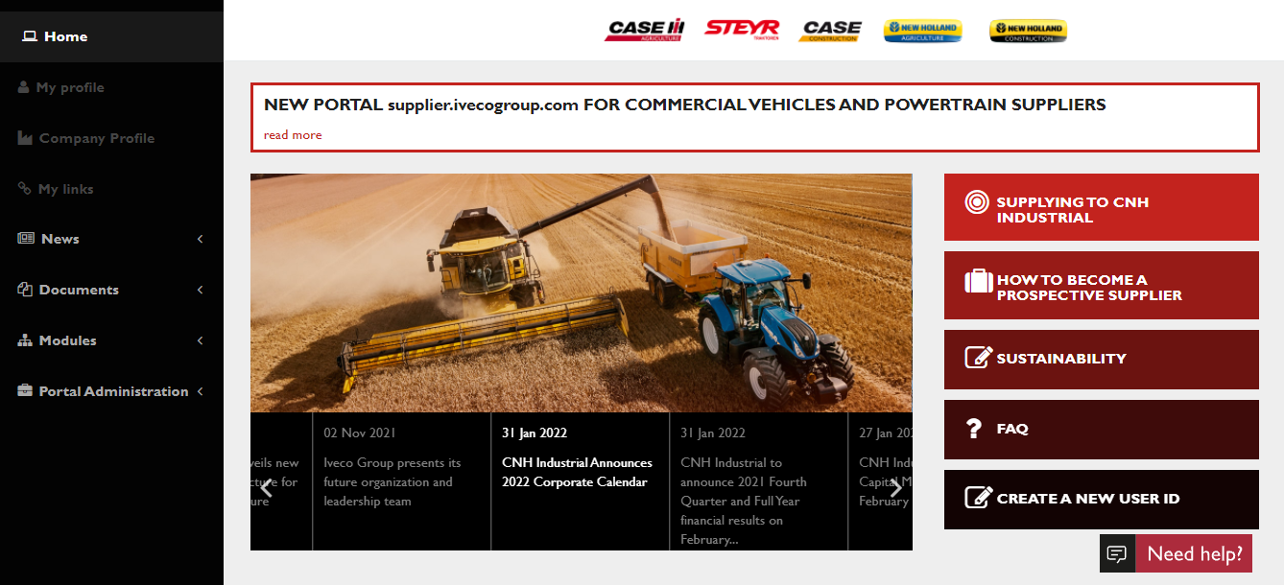
Sustainability Self Assessement Guide
Creating a new User Id on the CNH Industrial Supplier Portal
Connect to CNH Industrial Supplier Portal: https://supplier.cnhind.com and
Click on the “CREATE A NEW USER ID” on the homepage

Slide 6
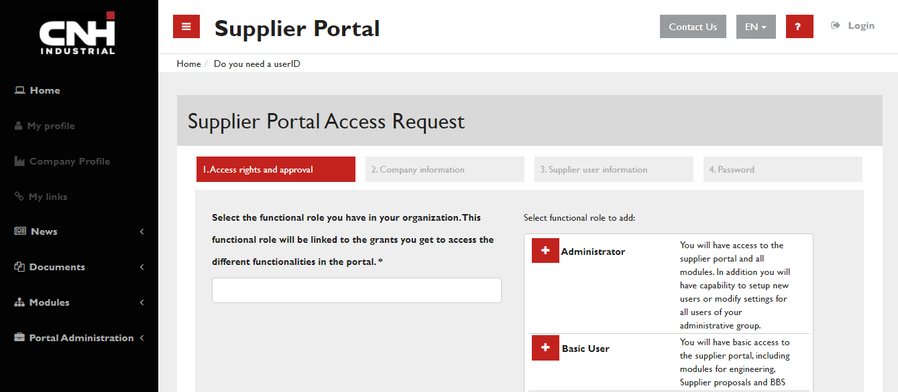
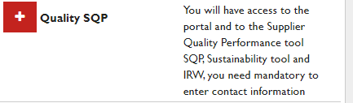
Choose “Quality SQP” functional role by clicking on “+”

Slide 7
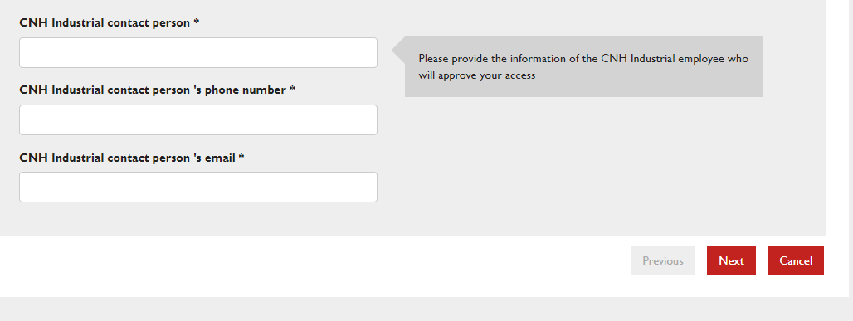
Sustainability Self Assessement Guide
Creating a new User Id
On the bottom of the same page, provide information of your contact person in CNH Industrial, who will approve your request. Click on Next.

Slide 8
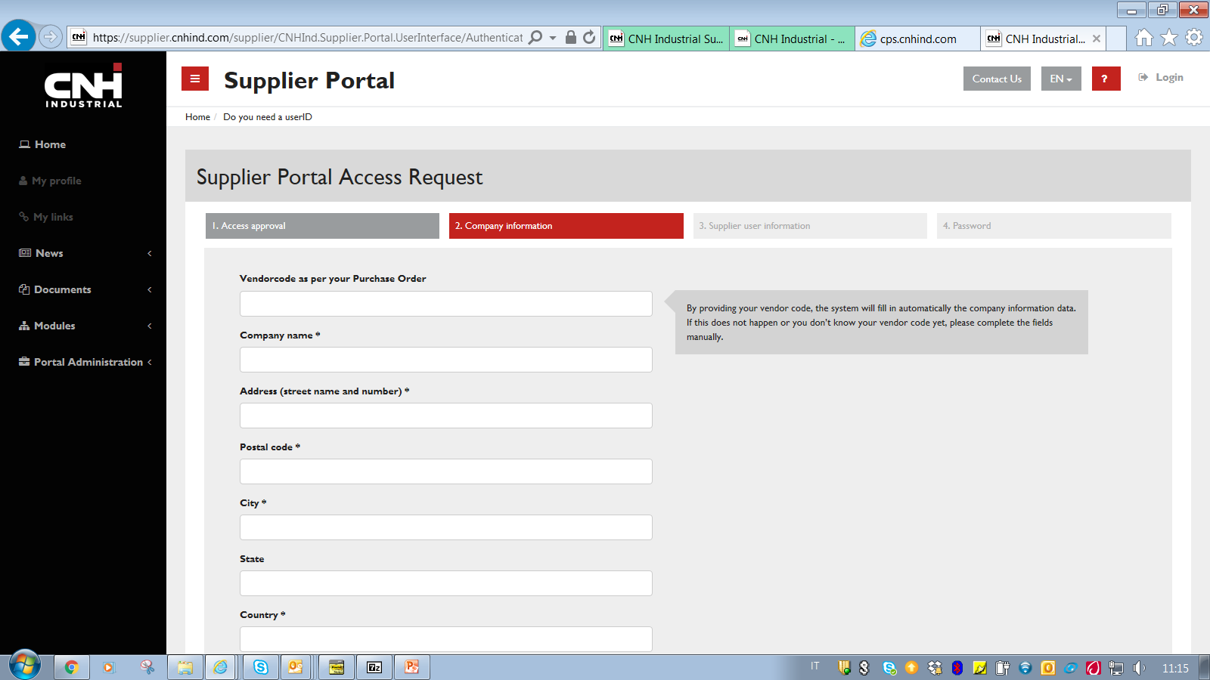
Sustainability Self Assessement Guide
Creating a new User Id
Fill in mandatory (*) fields under Access Approval, Company Information, Supplier User information and Password tabs. Upon approval by your CNH Industrial contact person, you will receive your access credentials by email.

Slide 9
Sustainability Self Assessement Guide
User with a User ID

Slide 10
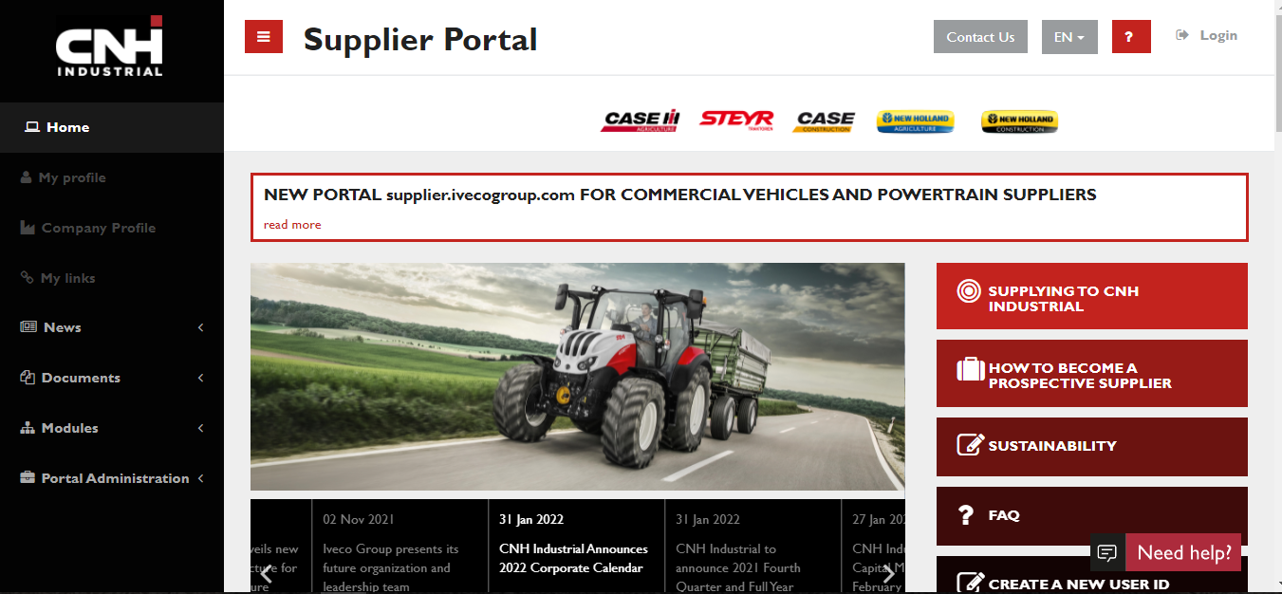
Sustainability Self Assessement Guide
Connect to CNH Industrial SUPPLIER PORTAL https://supplier.cnhind.com
Log in with your Portal user id and password
Click on «Sustainability»

Slide 11
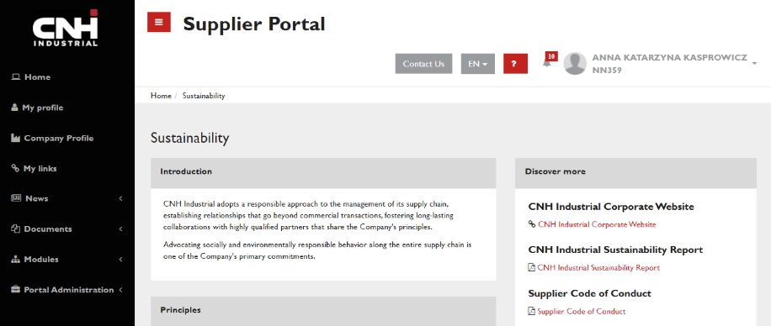
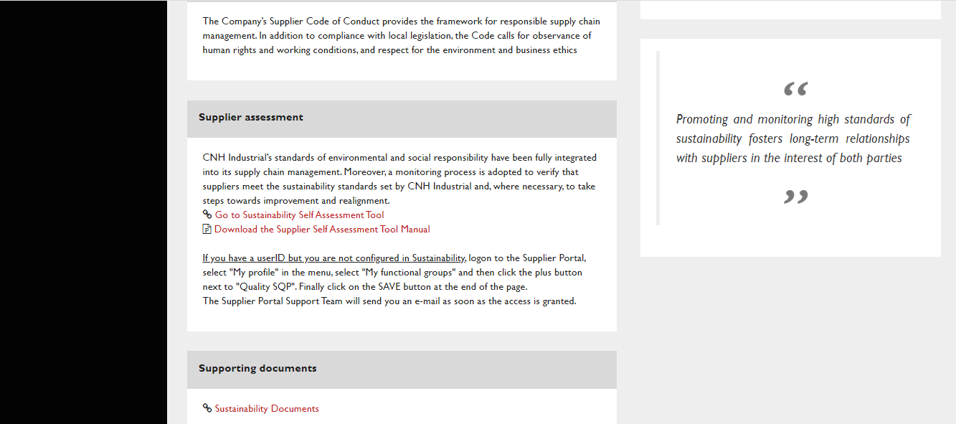
Click on

Slide 12
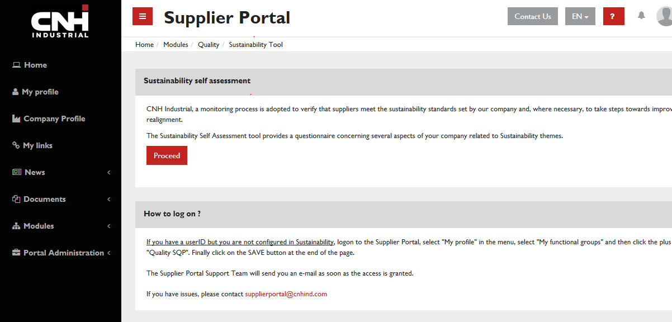
Sustainability Self Assessement Guide
Getting configured in Sustainability
Click on «Proceed» if you are configured for Sustainability

Slide 13
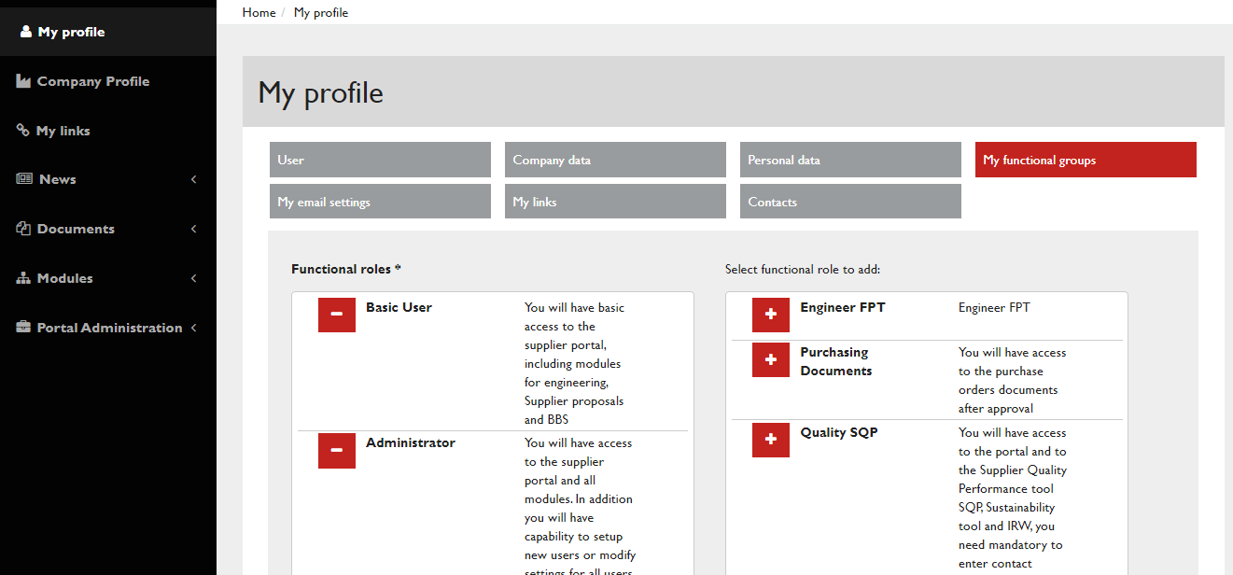

Sustainability Self Assessement Guide
Adding “Quality SQP” Functional Group to user’s profile
If you have a «User Id» but cannot access the tool after clicking “Proceed”, your user profile is not properly configured
To configure yourself in Sustainability, go to MENU > My Profile > My Functional Groups and add “Quality SQP” Functional Group to your profile by clicking on “+” and Save.

Slide 14
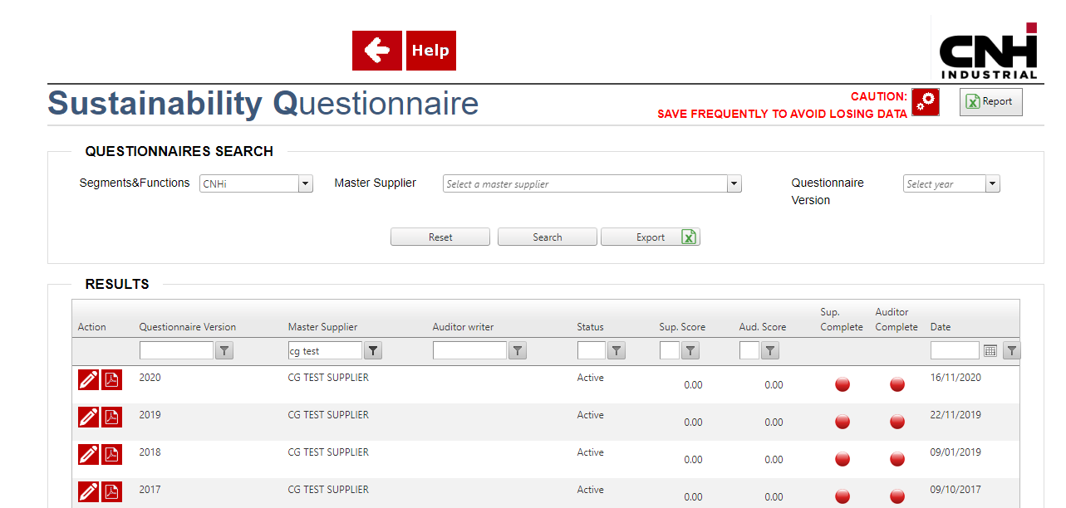
Sustainability Self Assessement Guide
1
2
3
1 - Enter the name of your company
2 – Click on Search
3 – Click on to open the 2022 SSSA

Slide 15
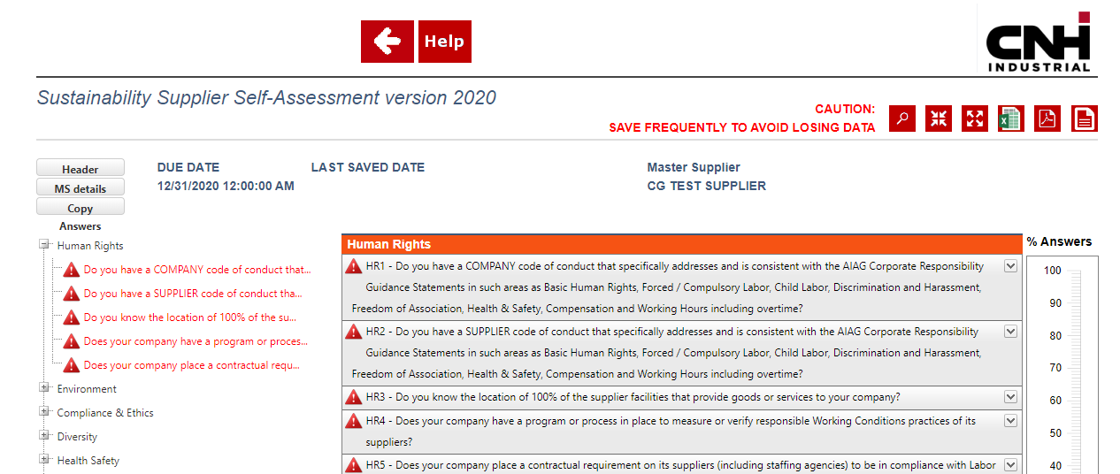
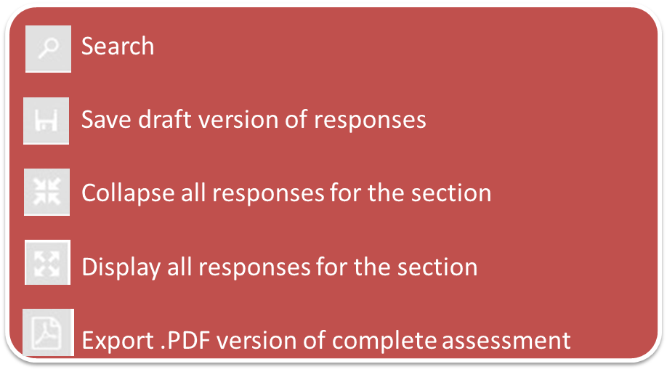
Sustainability Self Assessement Guide

Slide 16
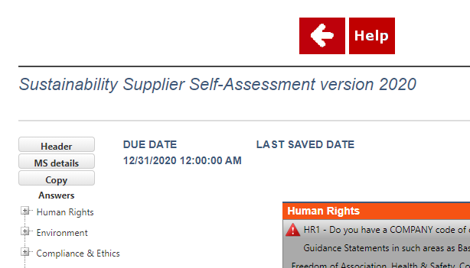
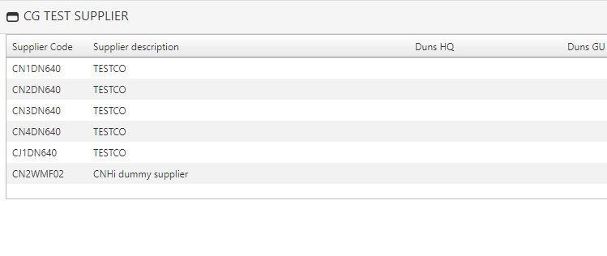
Sustainability Self Assessement Guide
Clicking on «MS Details» it is possible to view the composition of the Master Supplier.
Please see the next page for more details.

Slide 17
Sustainability Self Assessement Guide
Master Supplier structure
The Self Assessment Questionnaire is structured according to our Suppliers’ Company structure on Headquarter level (DUNS HQ) . For each Supplier Company, a Master Supplier has been created that corresponds to either:
1) a Headquarter according your Company Structure (DUNS HQ) or
2) a group of headquarters – aggregated in line with requests from previous years.
Each Master Supplier is linked to a single questionnaire to be answered.
You can request to change your Master Supplier structure :
- If the it does not correspond to your correct Company structure;
- if you need to provide answers to more than one Headquarter/Master Supplier;
- If you want to group more Headquarters under the same Master Supplier.
For example, if a holding company has a common sustainability strategy for all its Headquarters, they can all be aggregated under the same Master Supplier, so that the questionnaire will be answered one time for all of them.
On the opposite, if a Master Supplier contain codes that do not belong to the Headquarter, they can be removed.
Changes can be requested by opening a ticket through the HELP button within the tool.
See also: Supplier portal> MENU > Documents > Sustainability > Sustainability Self Assessment > SQP Suite Supplier Self Support Supplier user guide

Slide 18
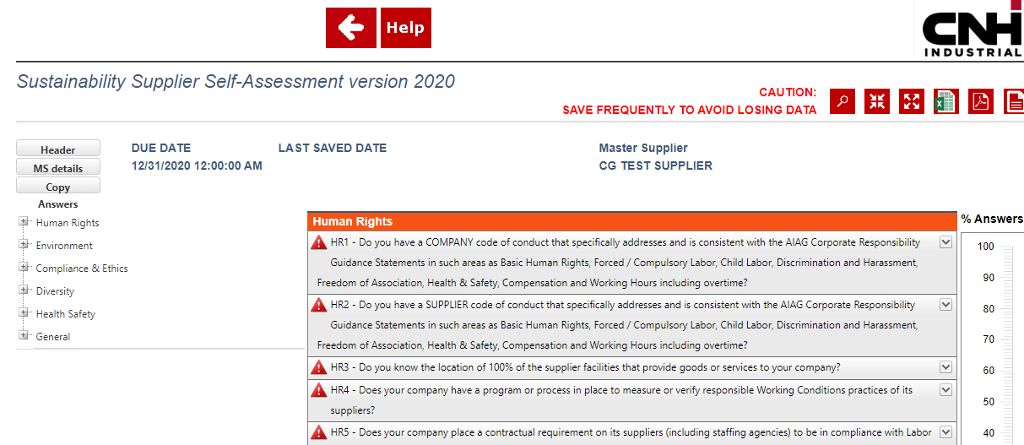
Sustainability Self Assessement Guide
Click to copy the answers from a previous year SSSA if already filled in

Slide 19
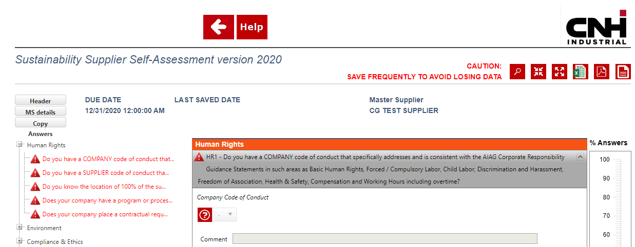
Sustainability Self Assessement Guide
For each question Enter your answers & comments
Click here to open and complete each question
% completed answers

Slide 20
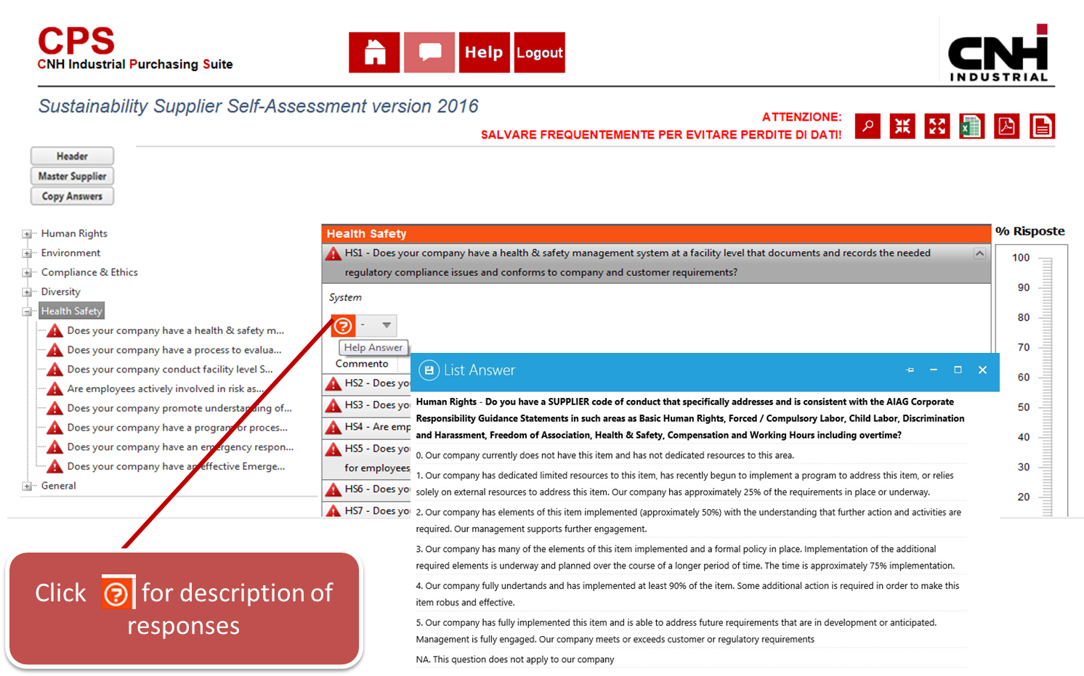
Sustainability Self Assessement Guide

Slide 21
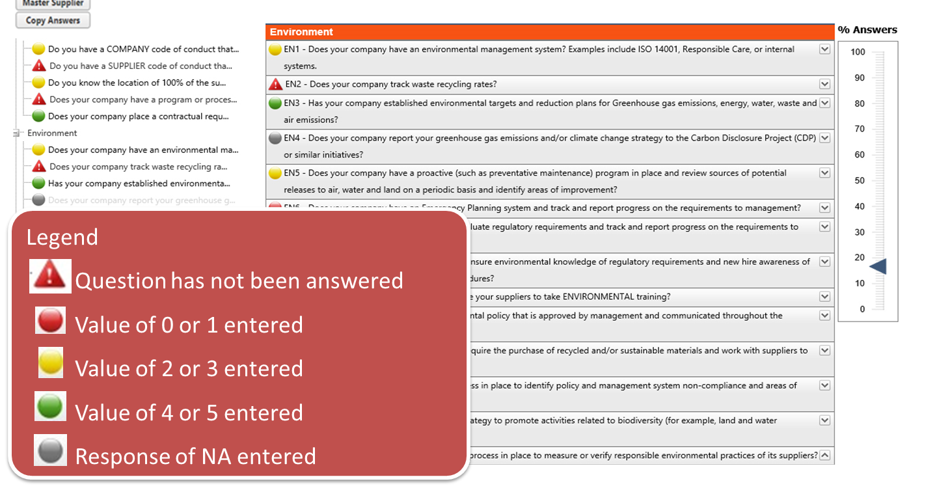
Sustainability Self Assessement Guide

Slide 22
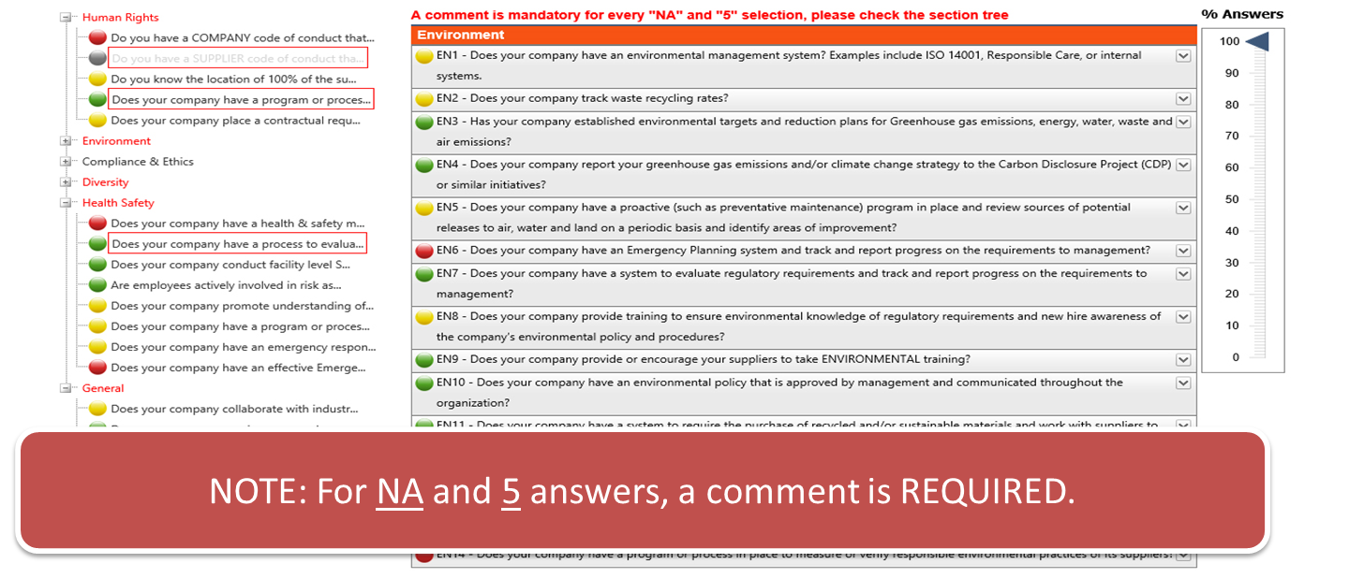
Sustainability Self Assessement Guide

Slide 23
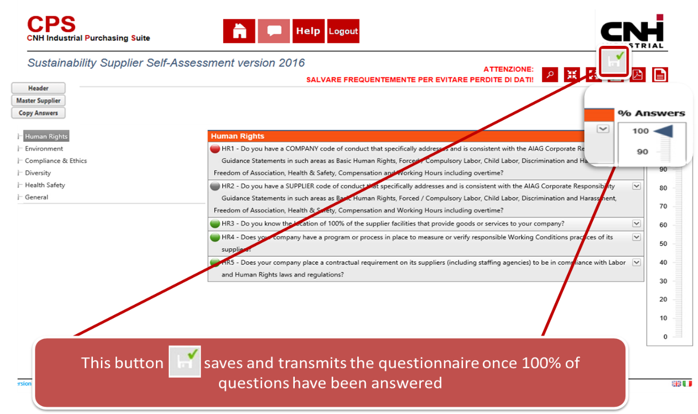
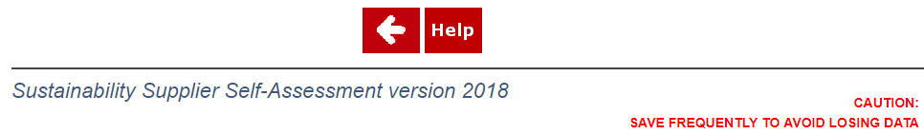

Sustainability Self Assessement Guide
Saving the questionnaire
IMPORTANT!
Please remember to save the questionnaire after completing it.

Slide 24


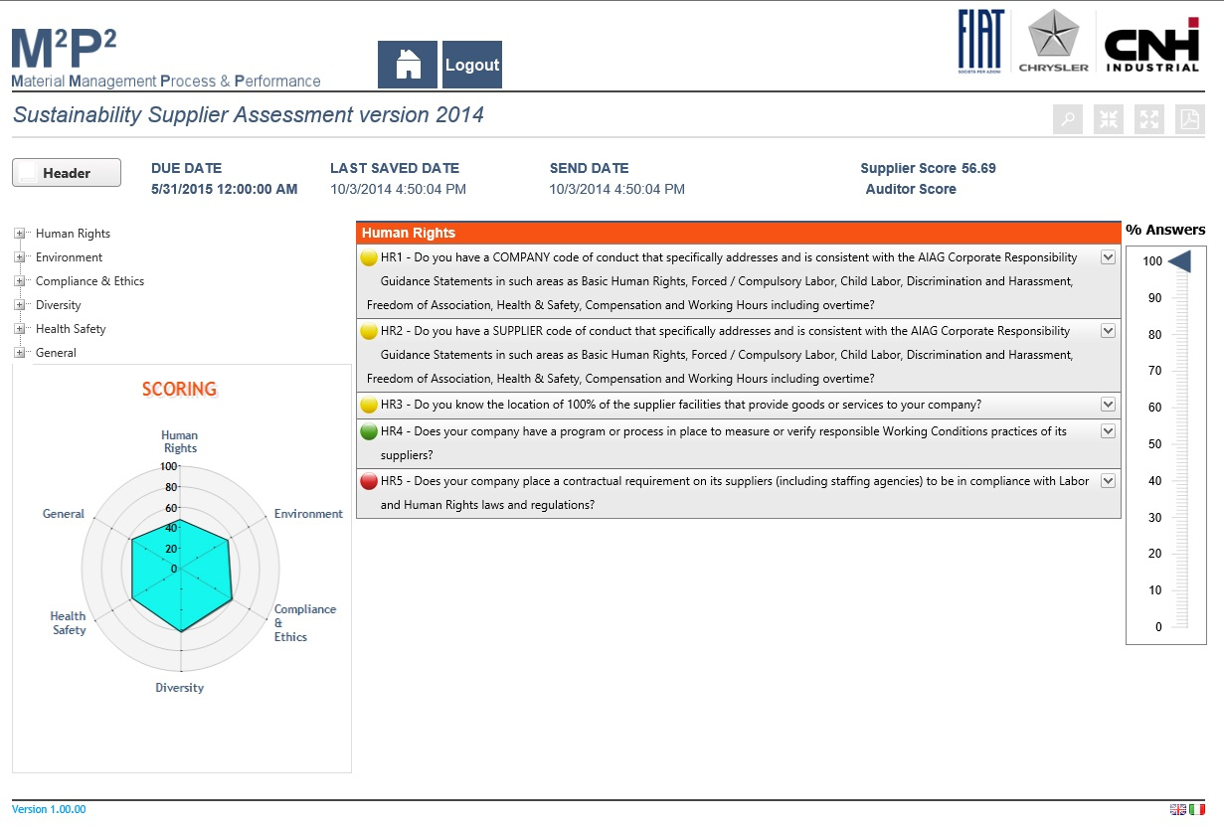
Sustainability Self Assessement Guide
Once the questionnaire has been sent, the final score and the radar chart are displayed

Slide 25
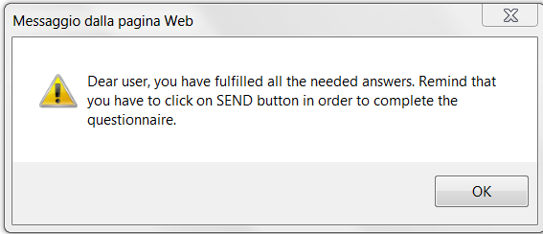

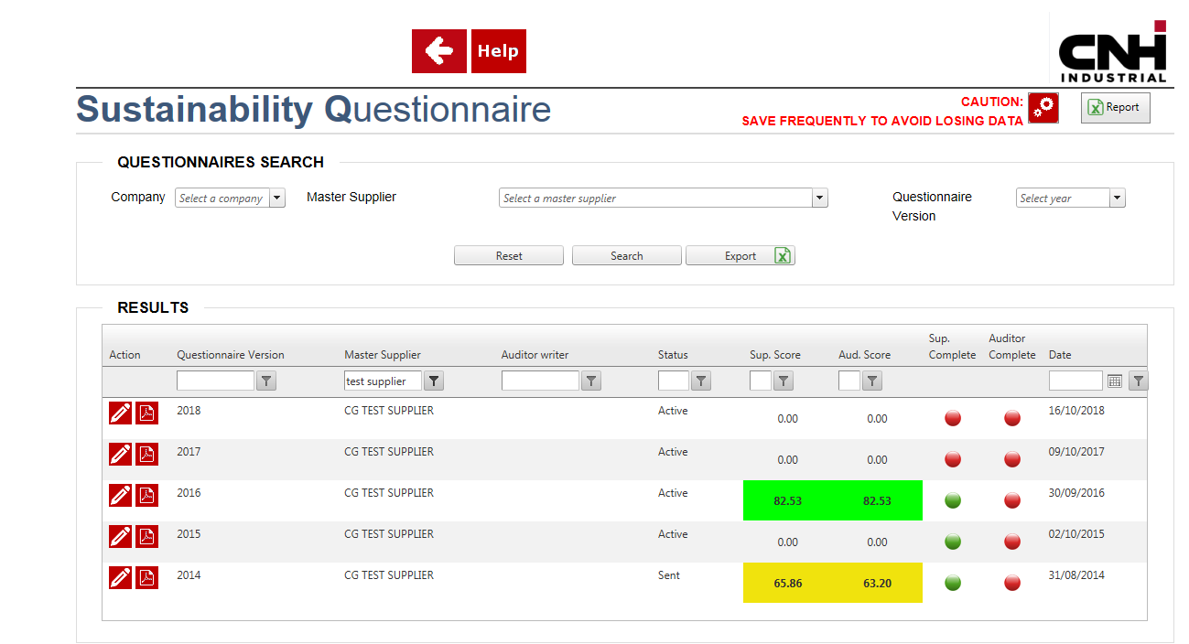
Supplier Sustainability Self Assessement
The questionnaire can be saved at any time (partially or totally) prior to sending.
Answers can be changed until final submission. After entering 100% of the answers, a dedicated message will remind you to click on the «send» button in order to finalize your submission.
Filled questionnaires that have not been sent will be considered definitive and automatically saved after the deadline.
The questionnaire can be always downloaded as .pdf file with responses you have provided.

Slide 26
Sustainability Self Assessement Guide
Help desk and support

Slide 27
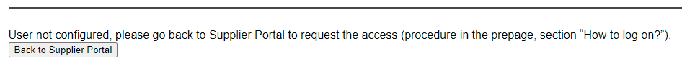
Supplier Sustainability Self Assessement
Frequently Asked Questions – Access Issues
ISSUES | SOLUTIONS
I am not registered to the portal | Please register as explained on page 5
I have a User Id, but I cannot access the questionnaire | Please configure your User ID as explained on page 13
I get an error message that my User ID is not configured: | Please configure your User ID as explained on page 13. If the problem persists, please send a message to supplieraccess@cnhind.com

Slide 28
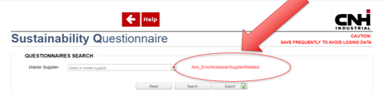
Supplier Sustainability Self Assessement
Frequently Asked Questions – Issues within the Sustainability Tool
ISSUES | SOLUTION
I don’t see my company on the drop-down list on the questionnaire search page | Please open a ticket through the HELP button – see ticket management guidelines on the following pages.
I see error in red on the questionnaire search page:
I have issues sending the questionnaire
I have sent the questionnaire but would like to re-open it and edit provided data

Slide 29
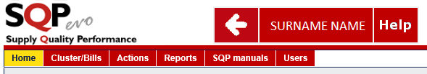
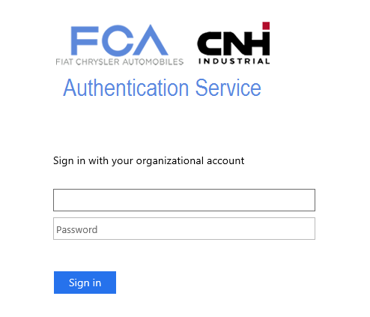
SQP Suite – Ticket management
HELP and Domain credentials
Click on HELP button
Insert your credentials:
Domain is «FGEXTRANET»
i.e. FGEXTRANET\W11111B
Domain\user

Slide 30
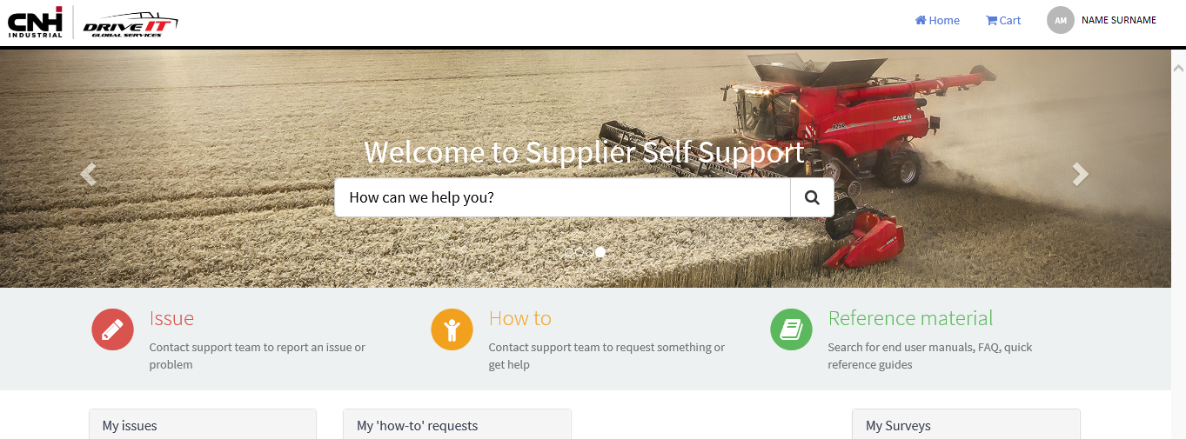
SQP Suite – Ticket management
Functionalities
  Click on «How to» on the Home Page Search if you need to obtain information regarding the application
  Click on “Issue” on the Home Page if you need to solve an issue

Slide 31
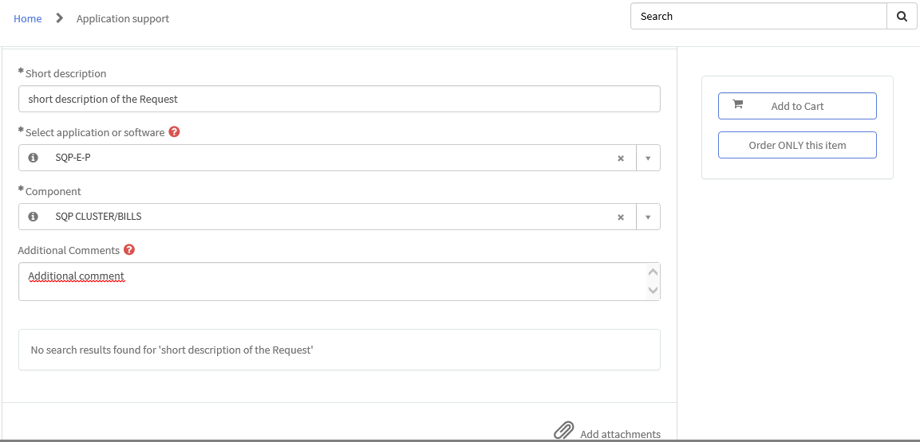
SQP Suite – Ticket management
Asking for guidance - How to
  Fill “Short description” field

Slide 32
SQP Suite – Ticket management
Asking for guidance - How to
  For SQP in Application write “SQP” and select “SQP-CNH-E-P“
  For IRW in Application write “IRW” and select “IRW-CNH-E-P”
  For SUSTAINABILITY write “SUSTAINABILITY” and select “SUSTAINABILITY-CNH-E-P”

Slide 33
SQP Suite – Ticket management
Asking for guidance - How to
  Select “Component” field, that is the area where you need information.

Slide 34
SQP Suite – Ticket management
Asking for guidance - How to
  Select “Order ONLY this item” to save your request

Slide 35
SQP Suite – Ticket management
Reporting an Issue
Click on HELP button
Insert your credentials:
Domain is «FGEXTRANET»
i.e. FGEXTRANET\W11111B
Domain\user

Slide 36
SQP Suite – Ticket management
Reporting an Issue
  Select “Issue” on the Home Page

Slide 37
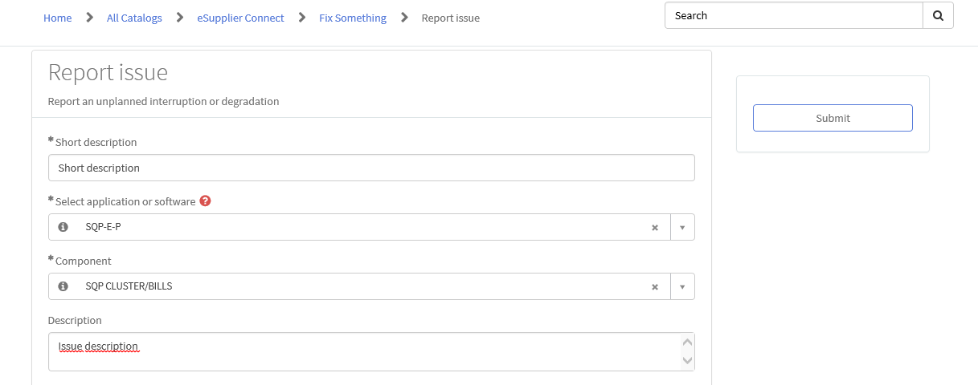
SQP Suite – Ticket management
Reporting an Issue
  Write a “Short Description” max 10 words

Slide 38
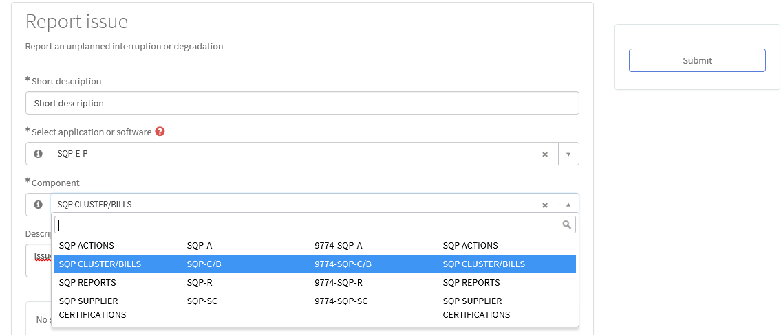
SQP Suite – Ticket management
Reporting an Issue
  In Application write:
  For SQP in Application write “SQP” and select “SQP-CNH-E-P“
  For IRW in Application write “IRW” and select “IRW-CNH-E-P”
  For SUSTAINABILITY write “SUSTAINABILITY” and select “SUSTAINABILITY-CNH-E-P”
  In Component select the correct issue area, where you want to report the issue

Slide 39
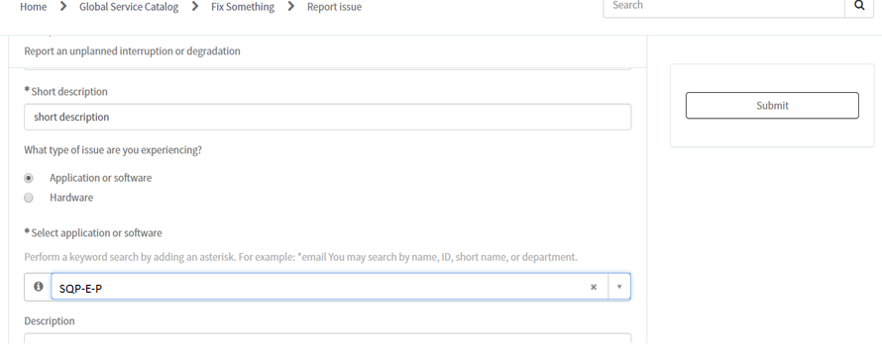
SQP Suite – Ticket management
Reporting an Issue
  When the form is completed, confirm it using the “Submit” button

