Slide 1
Internet Explorer mode on EDGE
Basic guide

Slide 2
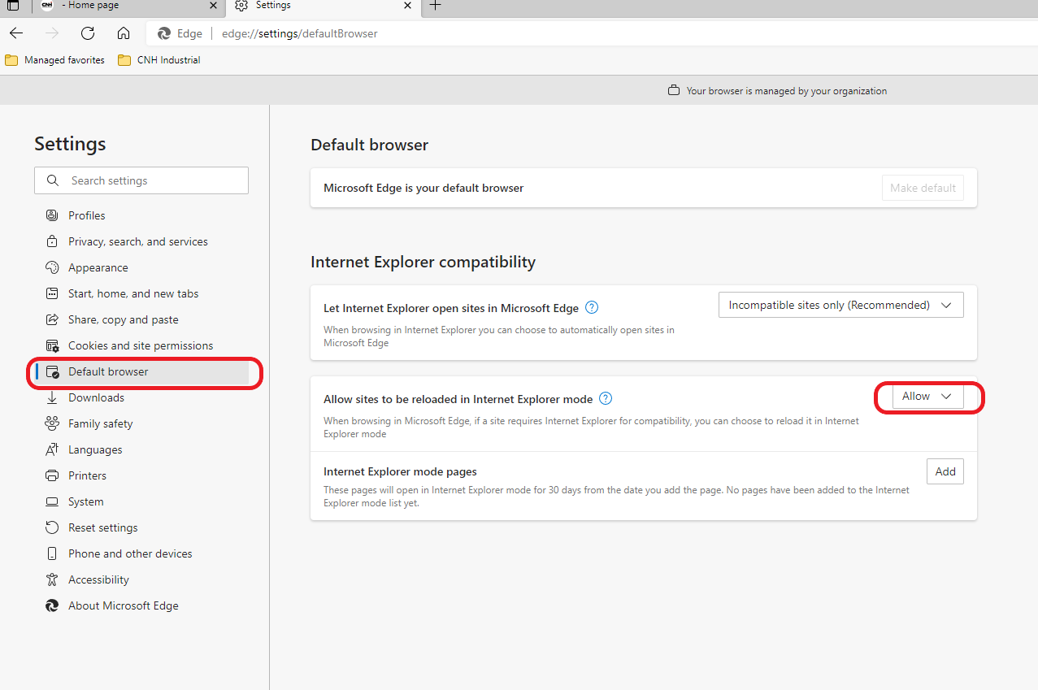
How to enable Internet Explorer mode in EDGE
Go to the EDGE settings page (edge://settings)
2. Click on
3. Select «Allow»

Slide 3
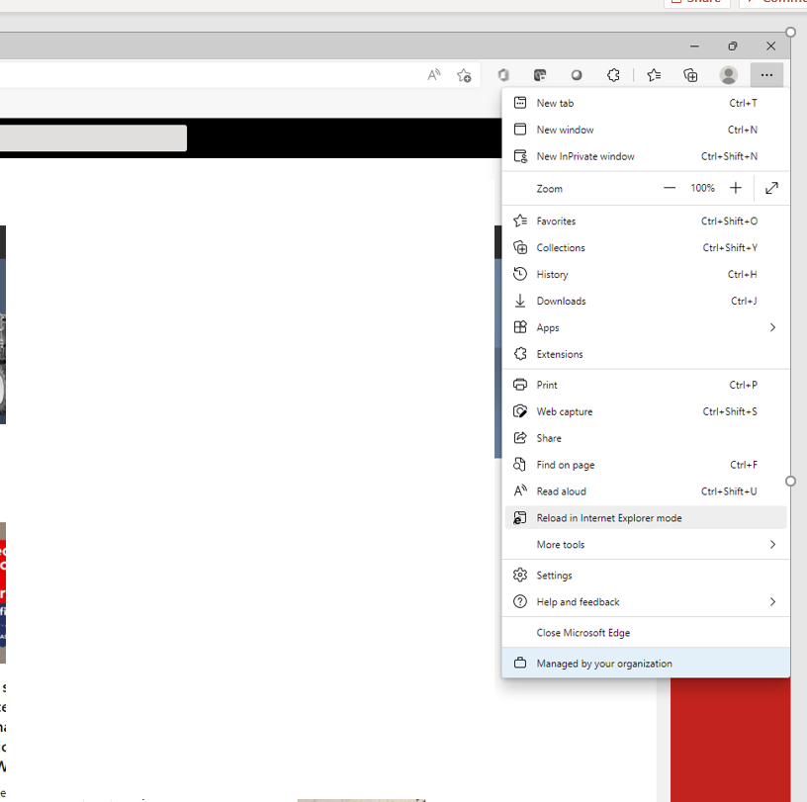
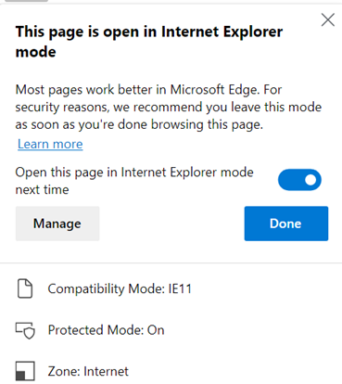
How to enable Internet Explorer mode in EDGE
1. Click on
3. Click on
4. Click on
2. Click on
Once the page is reloaded in Internet Explorer
mode, you’ll be prompted for making it permanent, so next time the page will be visited it will be showed in IE mode.
BEWARE: the setting will last 30 days (then, if needed, you’ll have to set it again)

